Slide 1
ITP PROJECT
Churn Prediction made usable
Power BI Dashboard + Azure SQL Database Adrian Liew (2302729)
Notes:
Open with the outcome: the churn model is no longer only a notebook result.
The work now supports exploration, live scoring and a cloud-backed reporting workflow.
[Sources]
- C:/Users/Lockheed/Desktop/GitHub/churn-prediction/body_converted_with_adrian.tex
- C:/Users/Lockheed/Desktop/GitHub/churn-prediction/ITP Weekly Report.pdf

Slide 2
A four-page report makes the model usable
One report, four levels of understanding
The report moves from customer detail to prediction, then explains the patterns behind churn.
This makes the modelling work understandable to people who do not use Python.
Explore
Churn Report - searchable customer records and slicers
Predict
Churn Risk Scorer - six inputs and a live probability
Explain
Churn Drivers - comparative charts for key risk factors
Understand
Customer Demographics - context on the customer base
02
Notes:
Explain that each page has a different job instead of repeating the same charts.
The sequence supports customer lookup, scenario testing, driver analysis and population context.
[Sources]
- C:/Users/Lockheed/Desktop/GitHub/churn-prediction/body_converted_with_adrian.tex (dashboard structure)
- C:/Users/Lockheed/Desktop/GitHub/churn-prediction/Churn Report.pbix

Slide 3
The reporting data stayed trustworthy
Clean reporting model
11 blank TotalCharges values fixed for zero-tenure customers and added four helper fields for clearer filtering and aggregation.
7,043
26.54%
0
customer rows retained
natural churn rate preserved
rows dropped or duplicated
03
Notes:
Stress that the dashboard represents the real customer population because no rows were removed.
The helper fields simplify Power BI visuals without changing the underlying information.
[Sources]
- C:/Users/Lockheed/Desktop/GitHub/churn-prediction/Telco_Churn_PowerBI_CLEANING_README.md
- C:/Users/Lockheed/Desktop/GitHub/churn-prediction/WA_Fn-UseC_-Telco-Customer-Churn.csv

Slide 4
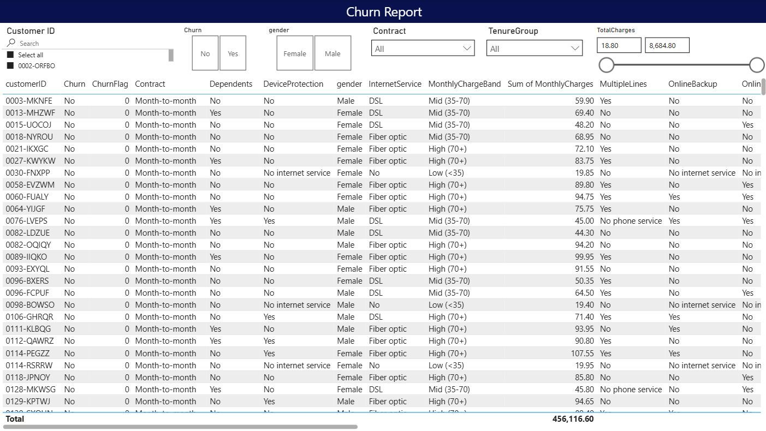
Explore churn in Power BI
Why a table and slicers
A customer-level table keeps the analysis auditable. Slicers for churn, contract, tenure and charges let users narrow the population instantly and inspect the exact records behind a pattern.
04
Notes:
Describe the table as an audit trail: every chart can be traced back to customer rows.
The slicers support fast segmentation without writing a new query for each question.
[Sources]
- C:/Users/Lockheed/Desktop/GitHub/churn-prediction/ITP Weekly Report.pdf (Power BI Churn Report screenshot)
- C:/Users/Lockheed/Desktop/GitHub/churn-prediction/body_converted_with_adrian.tex

Slide 5
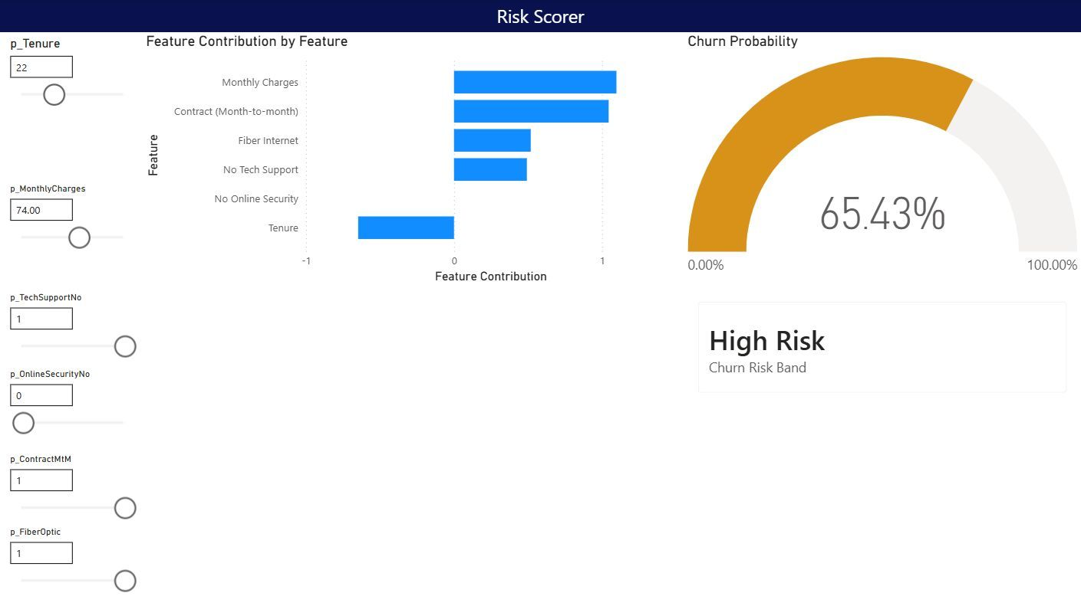
Explainable live scoring
Why this design works
Six SHAP-selected inputs feed a logistic equation written in DAX. The gauge communicates probability, the risk band simplifies interpretation, and the contribution bars show which selected features push risk up or down. Held-out AUC: 0.8362
06
Notes:
Emphasise that the published report does not need Python at runtime because the model equation is expressed in DAX.
The six-feature surrogate retained strong discrimination while remaining simple enough for interactive What-If controls.
[Sources]
- C:/Users/Lockheed/Desktop/GitHub/churn-prediction/Churn_Predictor_PowerBI_Guide.md
- C:/Users/Lockheed/Desktop/GitHub/churn-prediction/model_params.json
- C:/Users/Lockheed/Desktop/GitHub/churn-prediction/ITP Weekly Report.pdf (Risk Scorer screenshot)

Slide 6
Azure SQL removed the local-file bottleneck
BEFORE
MIGRATION
NOW
Local CSV
Refresh depended on a file stored on one analyst's machine.
Typed Azure table
Created dbo.telco_churn with a customerID primary key and explicit data types.
Cloud-backed report
Power BI now uses a central, refreshable source; credentials stay outside source control.
07
Notes:
Frame the migration as a workflow improvement, not only a technology change.
The central database makes the report portable, gives the schema consistent types and creates a clearer path to managed refresh and access control.
[Sources]
- C:/Users/Lockheed/Desktop/GitHub/churn-prediction/sql_scripts/create_table.sql
- C:/Users/Lockheed/Desktop/GitHub/churn-prediction/body_converted_with_adrian.tex (Azure SQL migration)

